Slide 1
Linear Regression – Gradient Descent Algorithm
Prof.N.L.Bhanu Murthy

Slide 2
Linear Regression
Advertising (in lakhs of rupees) | Sales (in lakhs of rupees)
10 | 520
20 | 625
35 | 700
50 | 780
Predicting sales of an item

Slide 3
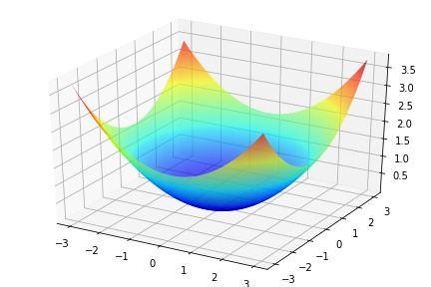
Linear Regression

Slide 4
Linear Regression

Slide 5
Linear Regression

Slide 6
Linear Regression

Slide 7
Linear Regression

Slide 8
Linear Regression

Slide 9
Linear Regression

Slide 10
Linear Regression

Slide 11
Linear Regression

Slide 12
Linear Regression

Slide 13
Linear Regression

Slide 14
Linear Regression

Slide 15
Regression

Slide 16
Thank You!

